Slide 1


MANUFACTURING ANALYSIS
MANUFACTURING ANALYSIS

Slide 2
TEAM MEMBERS
(GROUP 2)
Data Used :- Manufacturing Data
Tools used :- Excel, SQL, Tableau, Power Bi
Shravya Madipadige
T Shanti Priya Patro
Shubha Dorisetty
Rajkonda Nithya
Khushi Kumari

Slide 3
Shravya Madipadige
Khushi Kumari
Rajkonda Nithya
TEAM MEMBERS
(GROUP 2)
T Shanti Priya Patro
Shubha Dorisetty

Slide 4
CONTENT
05
04
01
03
02
Dashboard (performance summary)
Important insights
for
Success
&
growth
Comparison
charts
(Visual representa-
-tion
of data)
Introduction
to our
data
KPI
( Key
performance Indicators)

Slide 5
CONTENT
01
02
03
04
05
Introduction
to our
data
Comparison
charts
(Visual representa-
-tion
of data)
Dashboard (performance summary)
Important insights
for
Success
&
growth
KPI
( Key
performance Indicators)

Slide 6
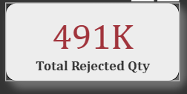
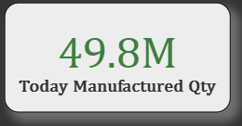
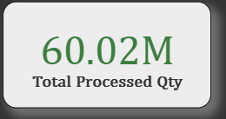
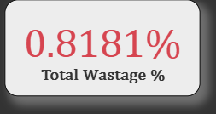
Total of Manufacturing:
1. Represents the total output of manufactured items over a given period
2. Production efficiency and capacity utilization.
3. Helps identify peak and low production periods
4. Supports planning and resource allocation decisions.
5. Serves as a benchmark for evaluating productivity improvements.
Insight:
High wastage indicates inefficiencies and the need for waste reduction strategies.
Total of Rejected:
1. Measures the total number of items rejected due to quality issues.
2. Reflects the effectiveness of quality control systems.
3. Highlights areas of waste and inefficiency in production.
4. Guides corrective actions for process or operator errors.
5. Impacts customer satisfaction, costs, and overall profitability.
Insight:
High wastage indicates inefficiencies and the need for waste reduction strategies.
Total Processed:
1. Represents the number of items successfully completed through the manufacturing process.
2. Indicates the proportion of production meeting quality standards.
3. Helps assess operational throughput and efficiency.
4. Used to benchmark productivity across departments or time periods .
5. Supports optimization of production schedules.
Insight:
A higher processed quantity signals effective processes and stronger quality compliance.
Total Wastage:
1. Measures the quantity of raw material wasted during production.
2. Highlights inefficiencies in resource utilization.
3. Provides visibility into cost leakages.
4. Indicates effectiveness of lean manufacturing practices.
5. Can be broken down by type of material wasted for targeted improvement.
Insight:
High wastage indicates inefficiencies and the need for waste reduction strategies.

Slide 7
Total of Manufacturing:
1. Represents the total output of manufactured items over a given period
2. Production efficiency and capacity utilization.
3. Helps identify peak and low production periods
4. Supports planning and resource allocation decisions.
5. Serves as a benchmark for evaluating productivity improvements.
Insight:
High wastage indicates inefficiencies and the need for waste reduction strategies.
Total of Rejected:
1. Measures the total number of items rejected due to quality issues.
2. Reflects the effectiveness of quality control systems.
3. Highlights areas of waste and inefficiency in production.
4. Guides corrective actions for process or operator errors.
5. Impacts customer satisfaction, costs, and overall profitability.
Insight:
High wastage indicates inefficiencies and the need for waste reduction strategies.
Total Processed:
1. Represents the number of items successfully completed through the manufacturing process.
2. Indicates the proportion of production meeting quality standards.
3. Helps assess operational throughput and efficiency.
4. Used to benchmark productivity across departments or time periods .
5. Supports optimization of production schedules.
Insight:
A higher processed quantity signals effective processes and stronger quality compliance.
Total Wastage:
1. Measures the quantity of raw material wasted during production.
2. Highlights inefficiencies in resource utilization.
3. Provides visibility into cost leakages.
4. Indicates effectiveness of lean manufacturing practices.
5. Can be broken down by type of material wasted for targeted improvement.
Insight:
High wastage indicates inefficiencies and the need for waste reduction strategies.

Slide 8

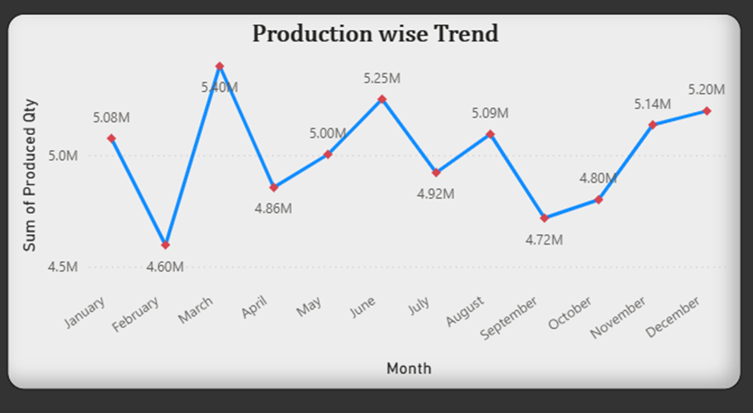
Definition:
A time-series view of production and rejection quantities, showing how both change over days, weeks, or months.
Insight:
Helps identify whether production is growing or declining and if rejection rates improve or worsen over time. Peaks in rejection can correlate with operational changes, staffing, or machine usage.
Actionable Insight:
Investigate periods where rejection spikes occur (new product runs, staff changes, maintenance gaps).
Correlate high production periods with rejection trends to ensure quality is maintained under stress.
Use trends to plan preventive maintenance during low-production periods.
Track progress of quality initiatives using this chart as a benchmark.

Slide 9

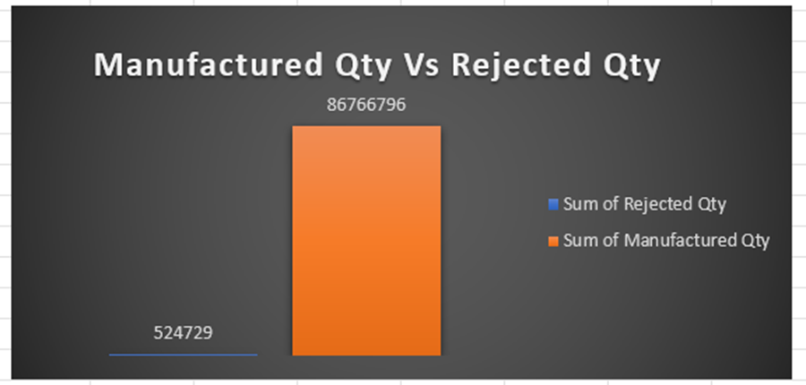
Definition:
Shows rejected quantity split by machine code, allowing evaluation of each machine’s performance.
Insight:
Machines with unusually high rejection counts may be miscalibrated, overdue for maintenance, or mismatched to the task. Machines with low rejection show stable performance.
Actionable Insight:
Schedule preventive maintenance or calibration for high-rejection machines.
Compare rejection patterns to machine age, settings, or operator to find causes.
Replace or upgrade machines with persistent issues.
Document and standardize machine settings from best-performing equipment.

Slide 10

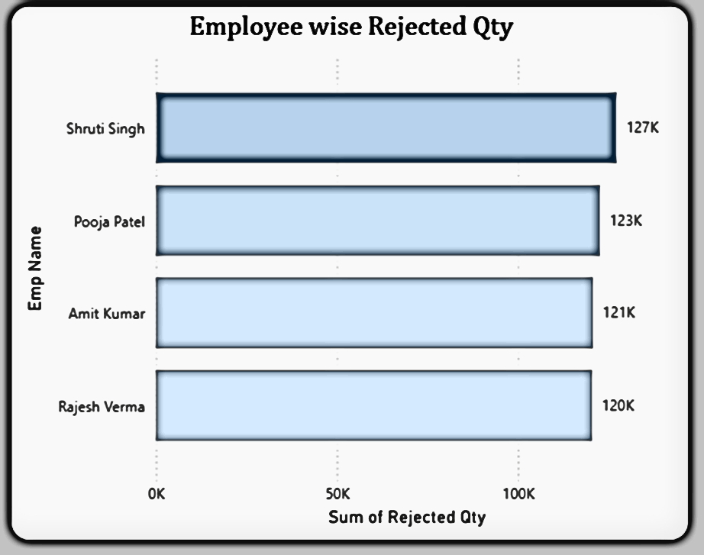
Definition:
This chart displays how many units were rejected for each employee. It reflects the individual’s output quality and adherence to standards.
Insight:
Some employees consistently show lower rejection rates, while others show higher. This reveals differences in skill level, attention to detail, or training effectiveness.
Actionable Insight:
Provide targeted training to employees with higher rejection counts.
Investigate whether high rejections are due to task complexity or lack of resources.
Share best practices from top performers with others.
Consider incentive programs tied to quality improvements.

Slide 11

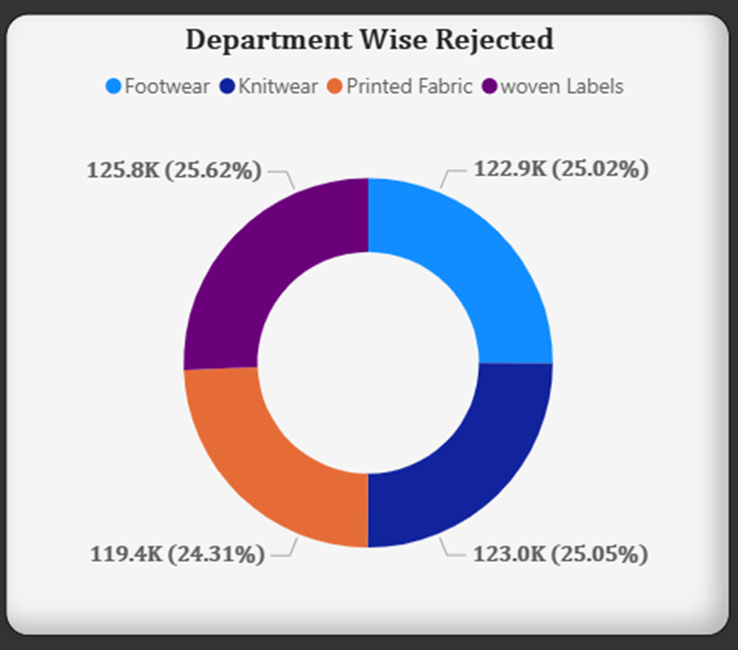
Definition:
This chart shows the breakdown of manufactured quantities and rejected quantities by department.
Importance:
Identifies areas for improvement and allocation of resources.
Insight:
Variations in manufacture and rejected quantities among departments indicate areas for improvement.
Actionable Insight:
Allocate resources and prioritize quality improvement efforts based on departmental performance.

Slide 12

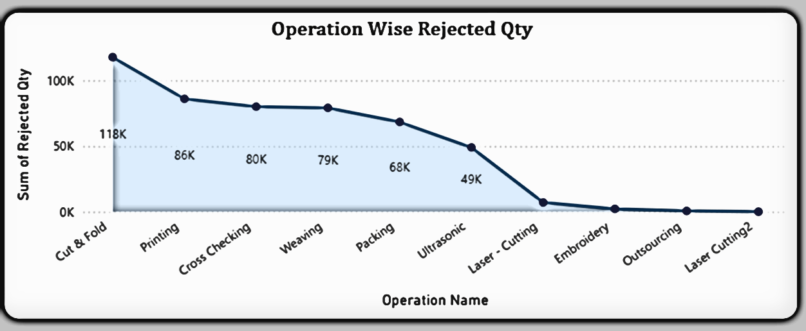
Definition:
This chart depicts quantity of rejected items attributed to specific operations.
Importance:
Identifies areas of improvement within the manufacturing process
Insight:
Quantity of rejected items attributed to specific operations helps identify bottlenecks and inefficiencies in the manufacturing process.
Actionable Insight:
Analyze and optimize operations with high rejection quantities to improve overall process efficiency and product quality.

Slide 13

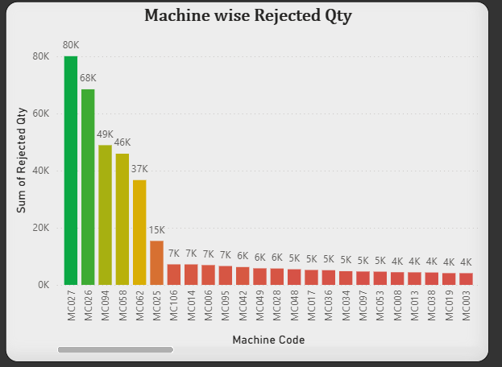
Definition:
This chart shows the comparison between total manufactured quantity and total quantity rejected.
Importance:
Evaluates the efficiency and quality of the manufacturing process.
Insight:
Comparing manufactured quantity to rejected quantity provides insights into the effectiveness of quality control measures.
Actionable Insight:
Set quality targets and implement continuous improvement initiatives to reduce the proportion of rejected quantity.

Slide 14
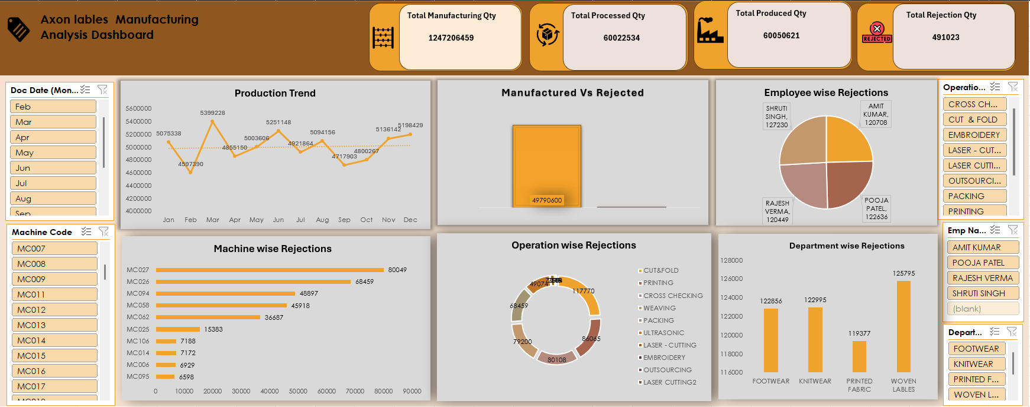

Slide 15
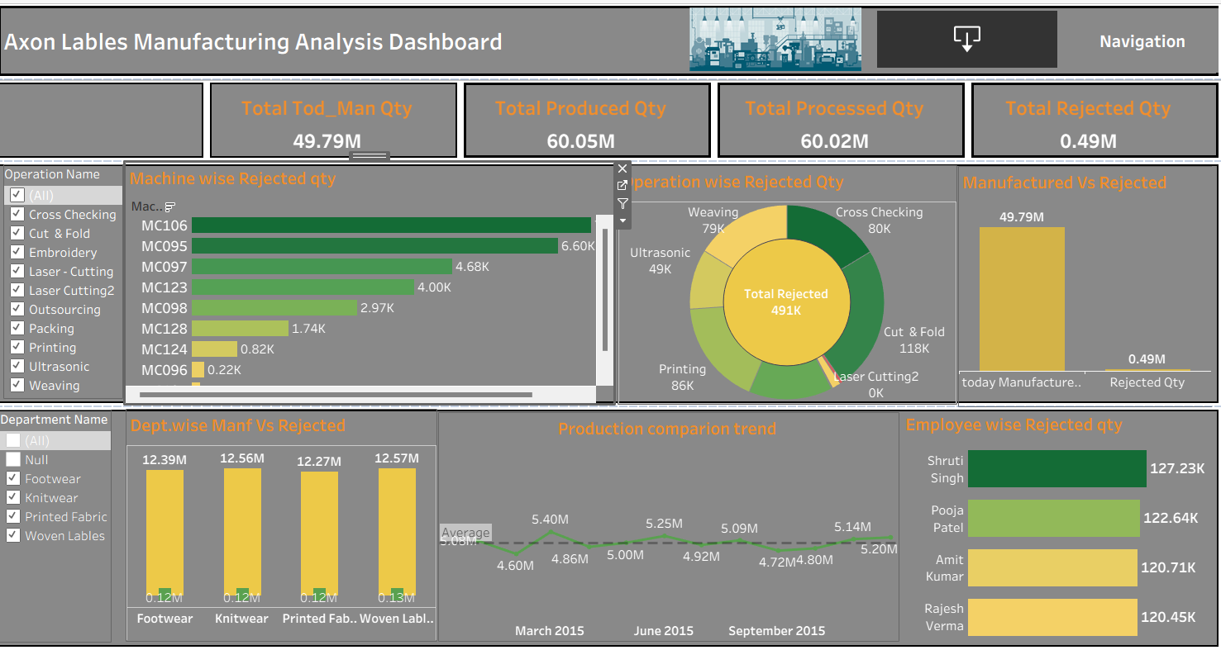

Slide 16
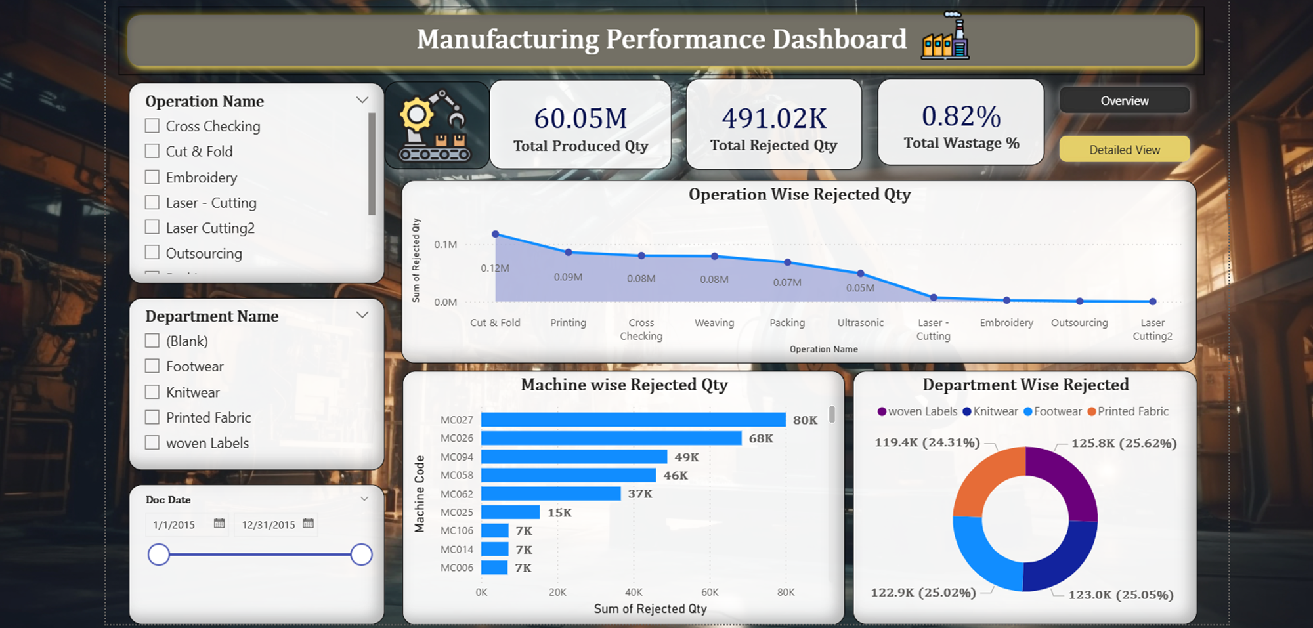

Slide 17

Data Insights
Manufacturing employer ‘Sruthi Singh’ faced the highest rejections.
Also, department ‘woven labels’ type faced most rejections.
Solutions
Improving the efficiency of operational methods.
All the above sources of rejections should really inspect reasons as to why their products are being rejected and take actions like:-
Provide skill training for the employers.
Introduce smart technologies.
Invest in quality raw material and monitoring of logistics process
Products manufactured by machines with code C007,C022,C0037,are rejected highly.
And during the operation ‘cut & fold’ high number of products were rejected.

Slide 18


